Slide 1
A Look Inside the Largest Python Course in the World
Dr. Charles Severance
University of Michigan School of Information

Slide 2
TL;DR;
I am obsessed with advancing Educational Technology.

Slide 3
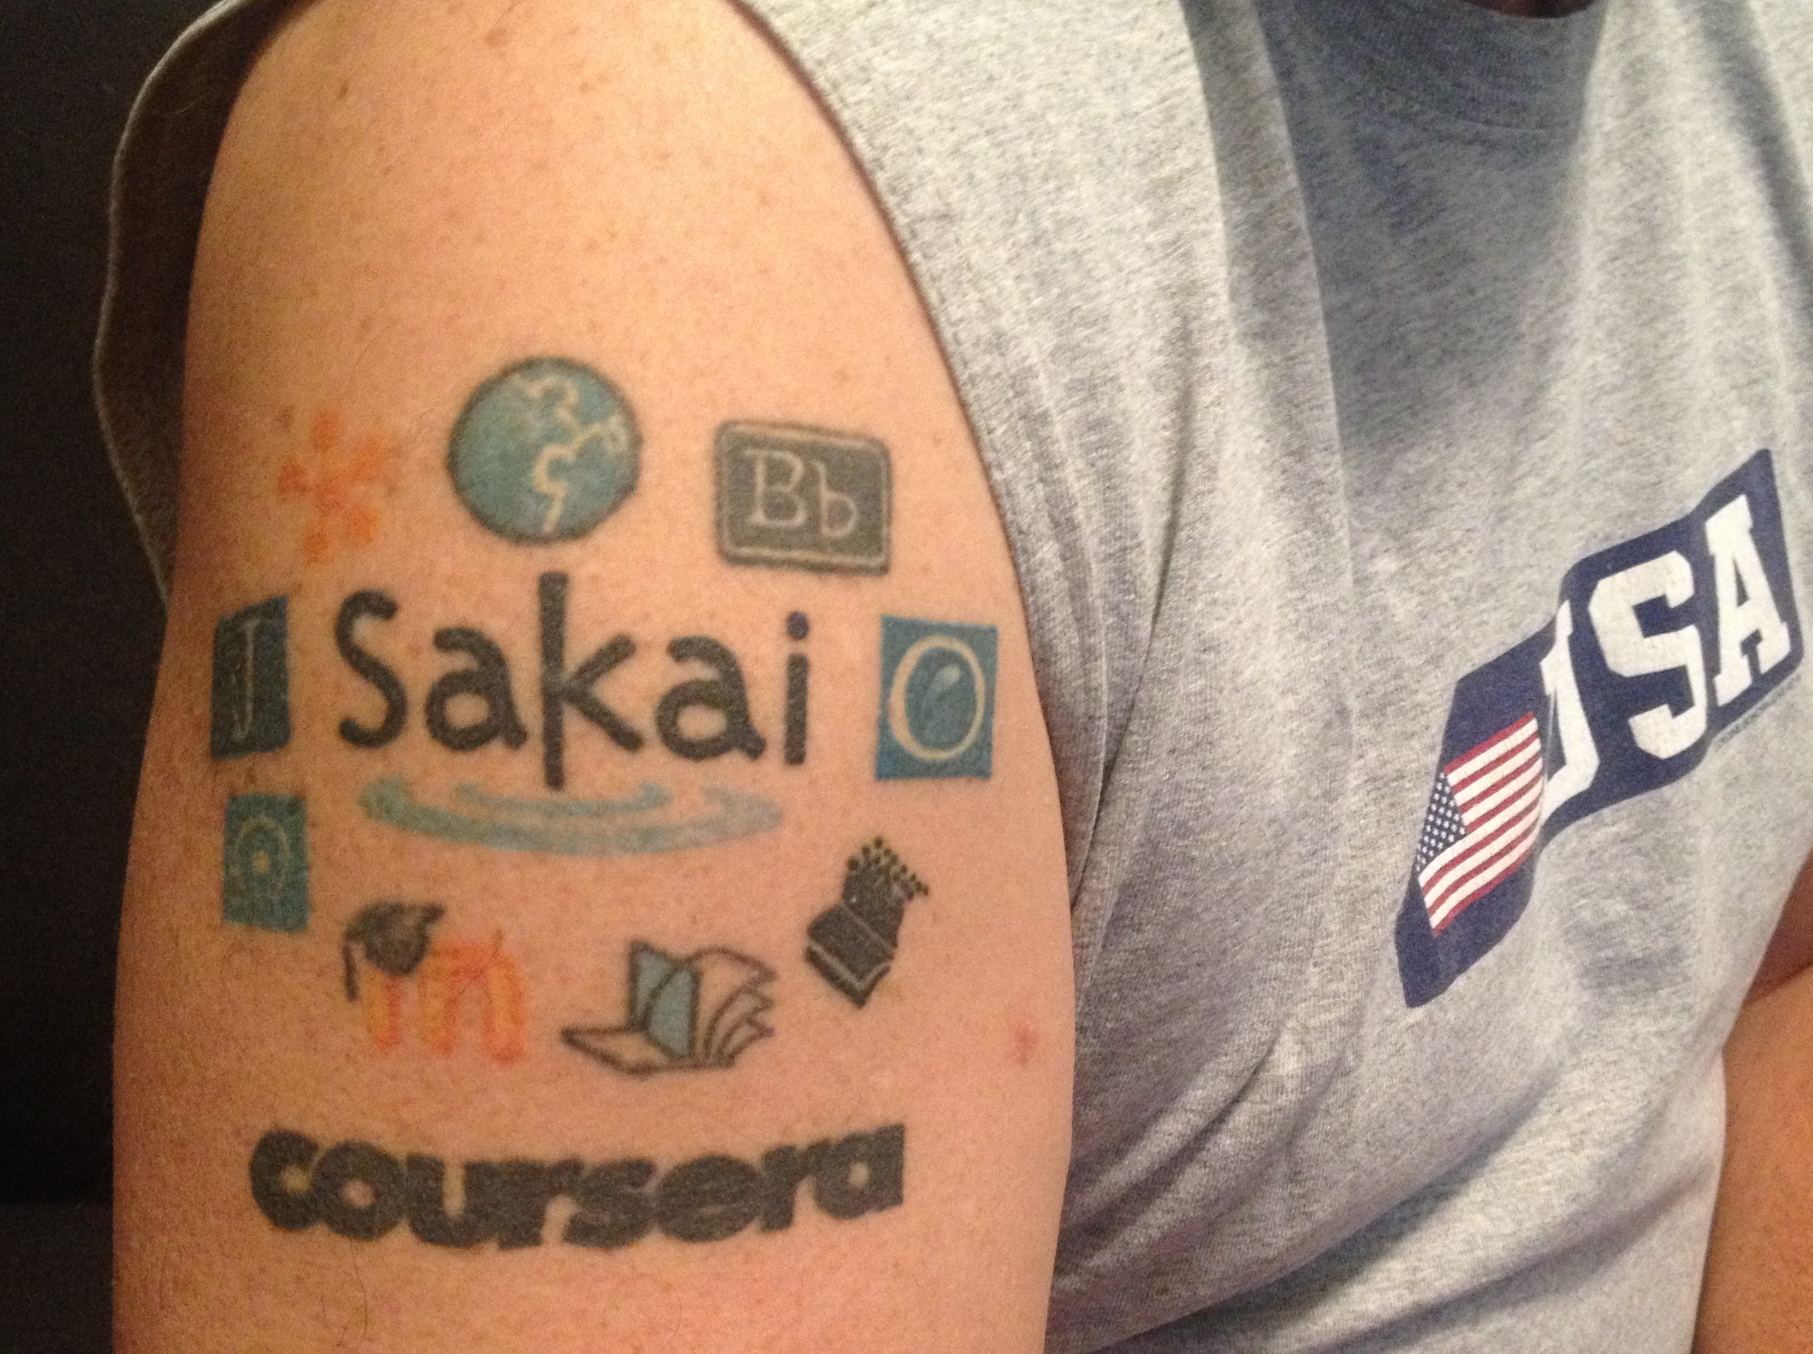
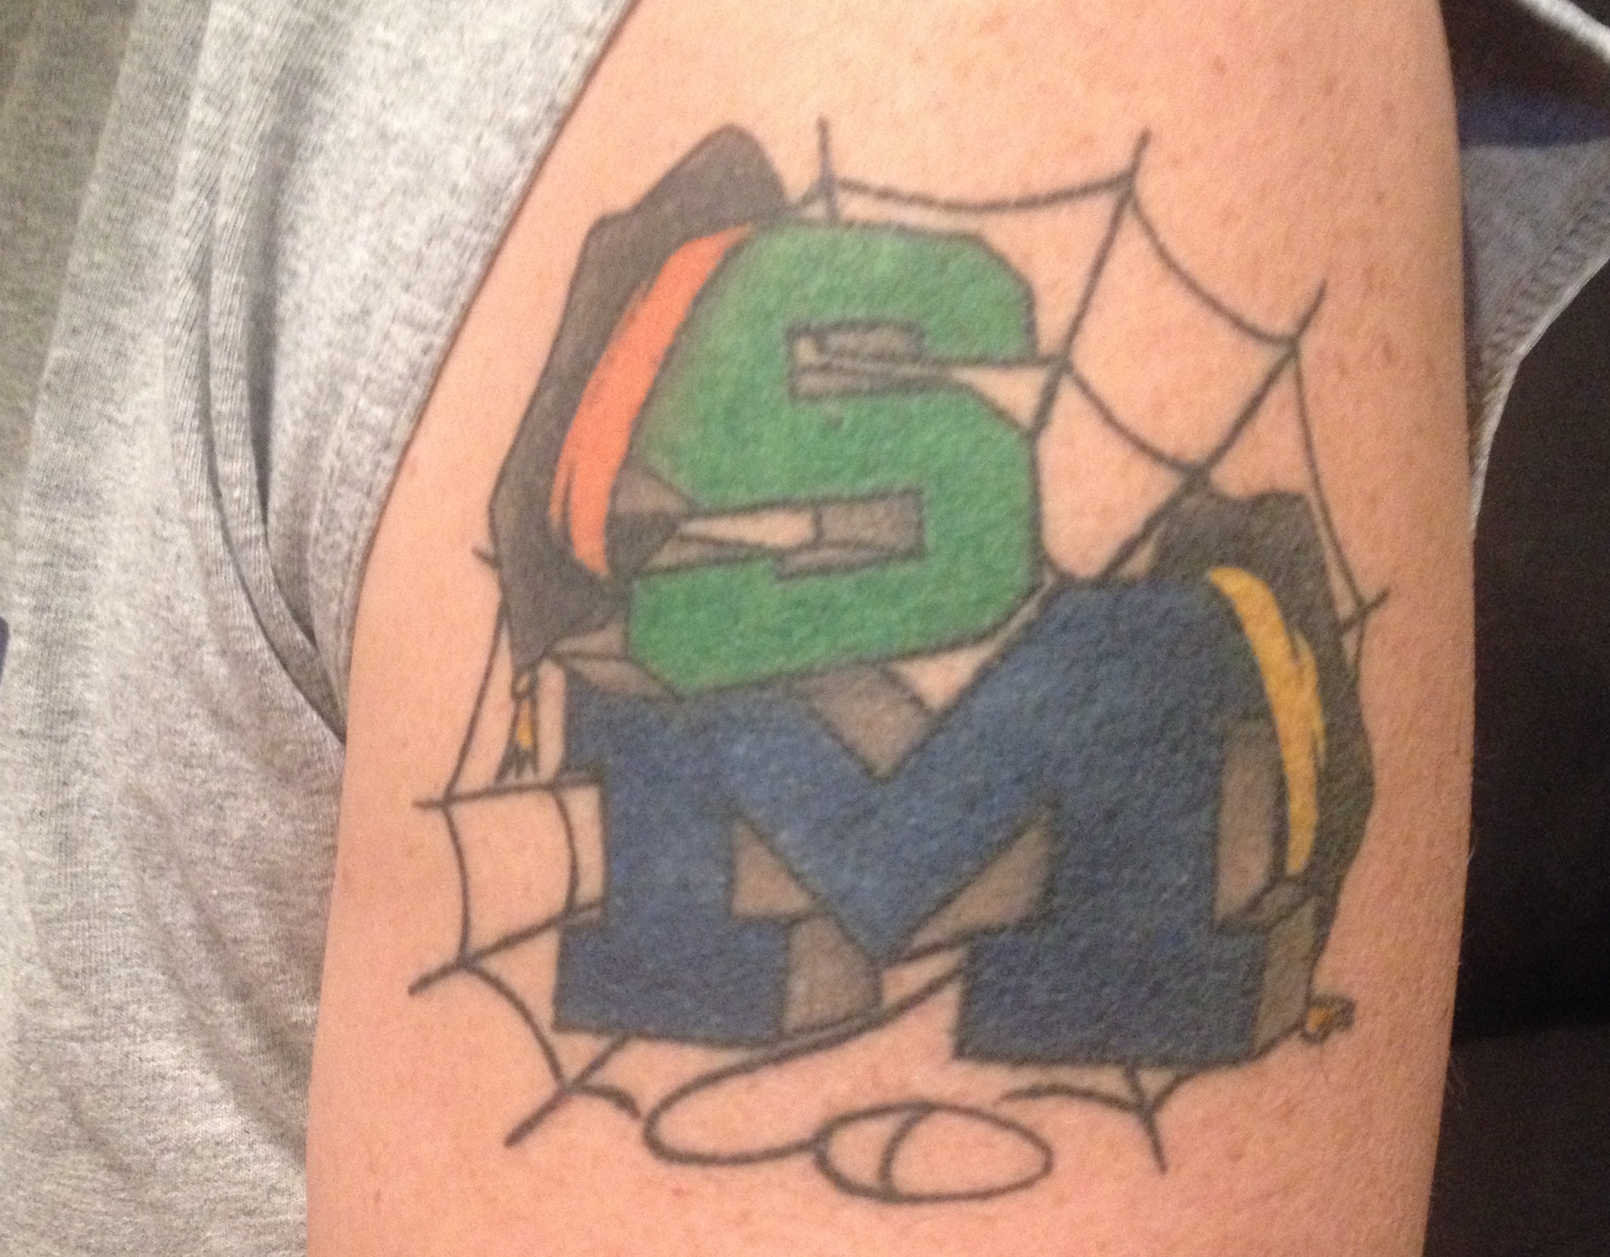

Slide 4
What is a MOOC?
Circa 2012: Massively, Open, Online, Course
Circa 2018
Scalable from 10 to 100K+ students without greatly increasing costs
Open Admission – Might charge fee of less than $100
Online – Yup
Four week unit (about 1 credit)
Providers
www.coursera.org
www.edx.org
www.futurelearn.org
www.udacity.com
www.udemy.com

Slide 5
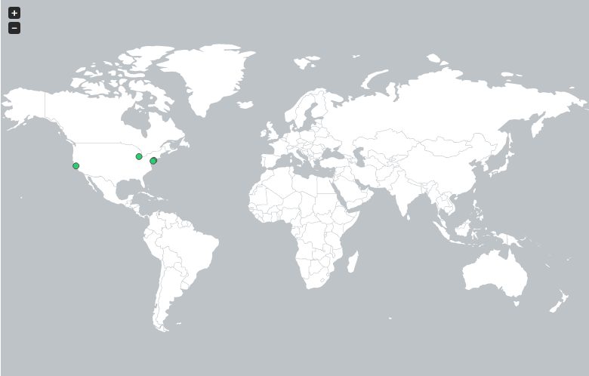
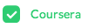
http://edutechnica.com/moocmap/
April 2012
Notes:
But let me take you back 18 short months when there was only one provider of MOOCs with only four Universities (University of Pennsylvania, Stanford, Michigan, and Princeton). It was just an experiment in early 2012 and I was fortunate to even know about the emerging effort – let alone be given a chance to teach this new type of course for the University of Michigan.

Slide 6
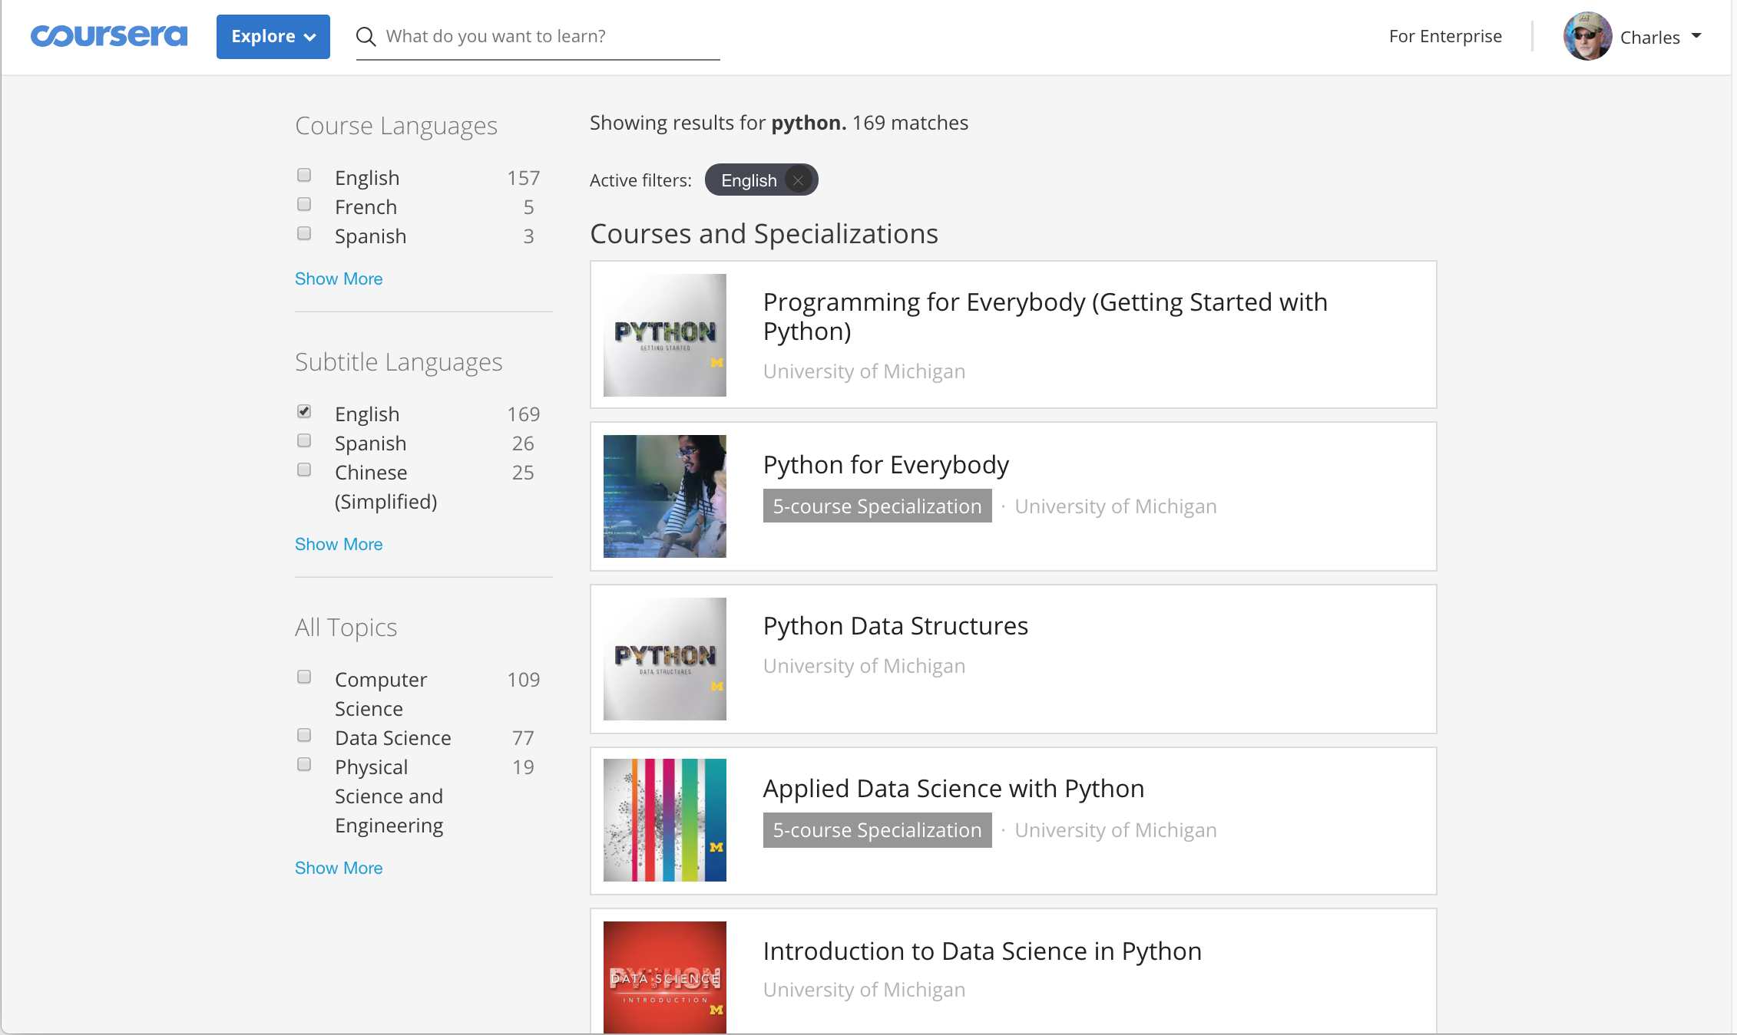

Slide 7
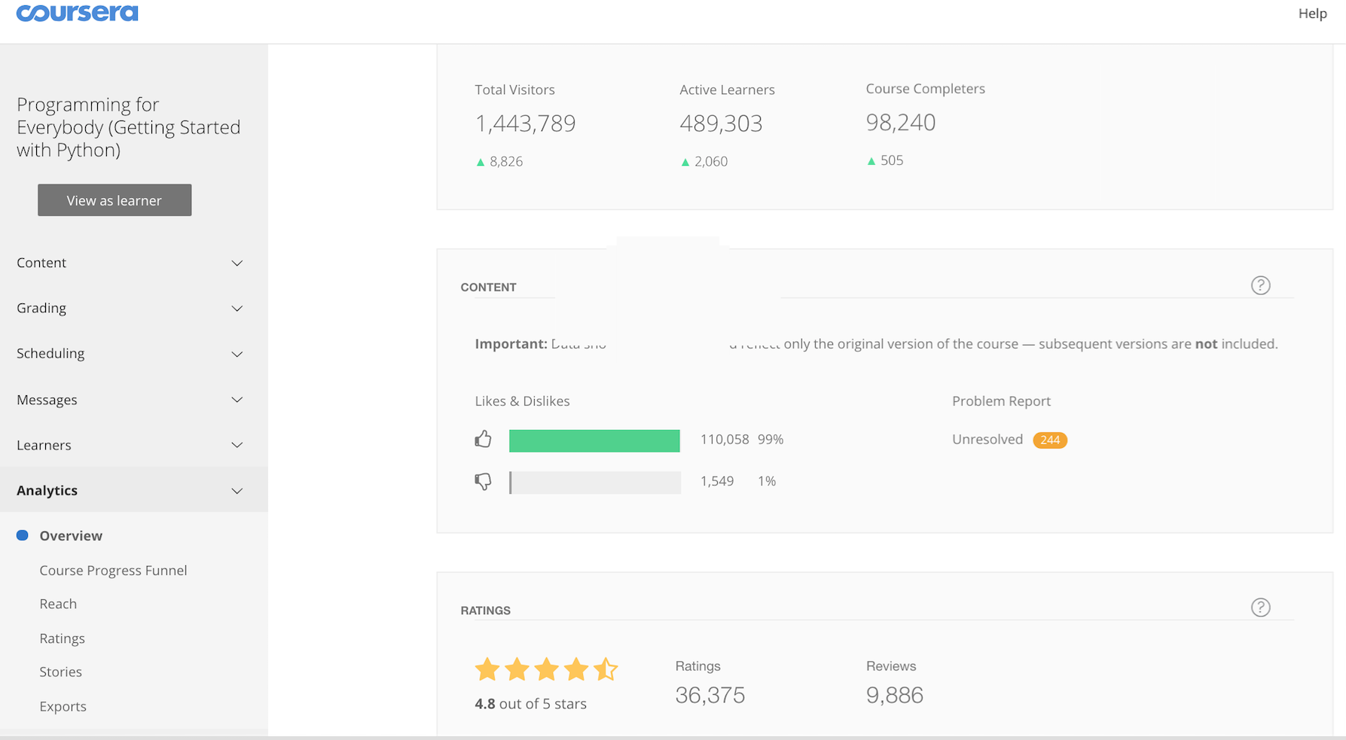

Slide 8


Slide 9
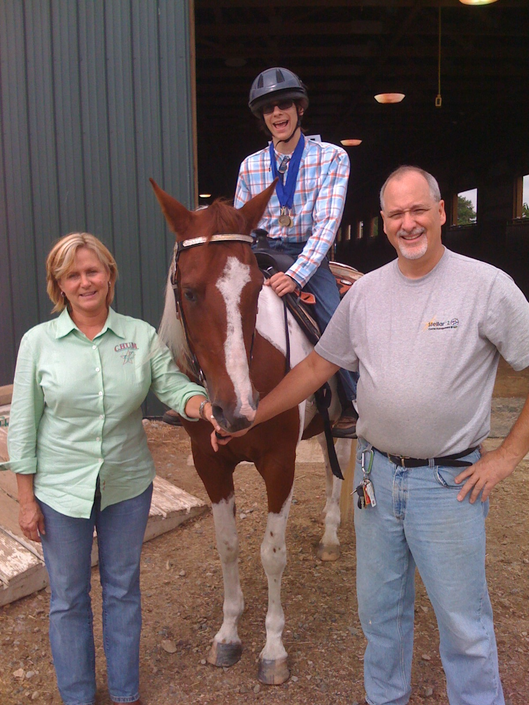

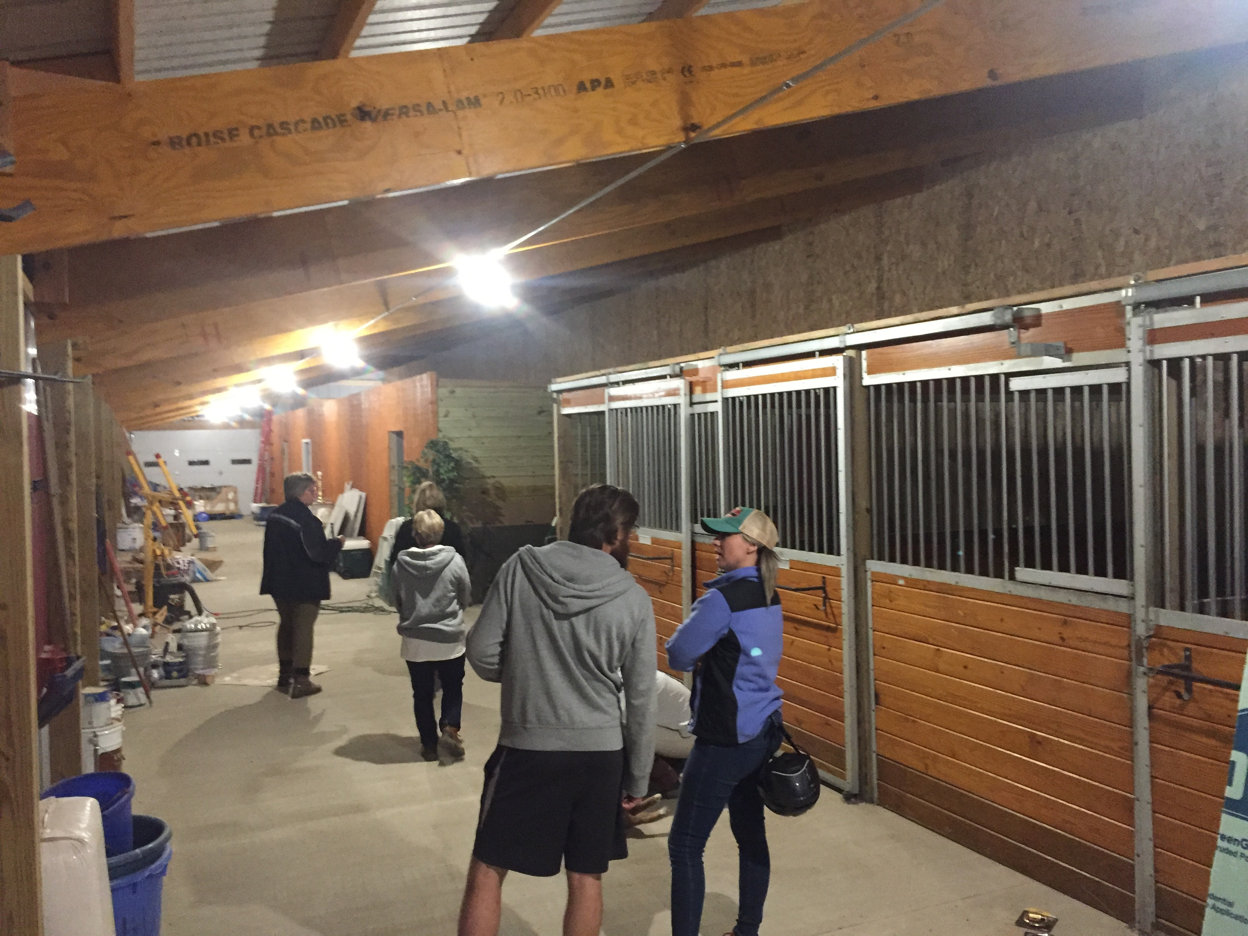


Slide 10
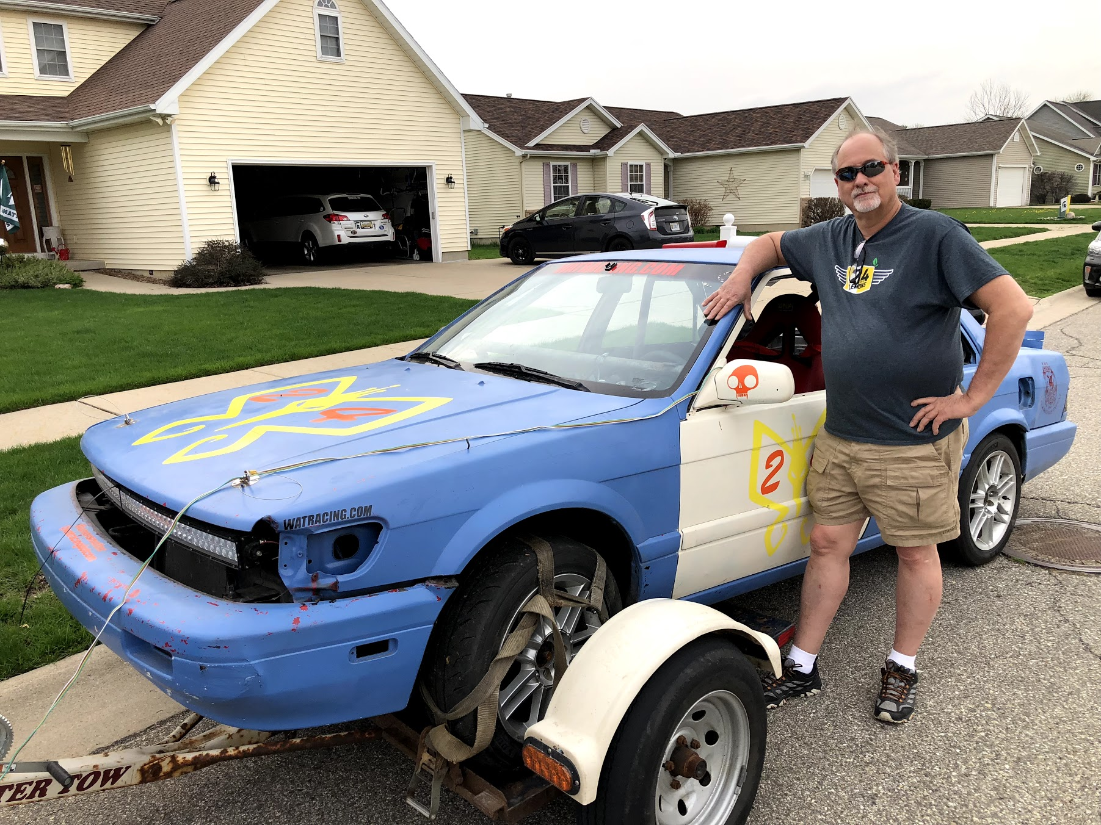
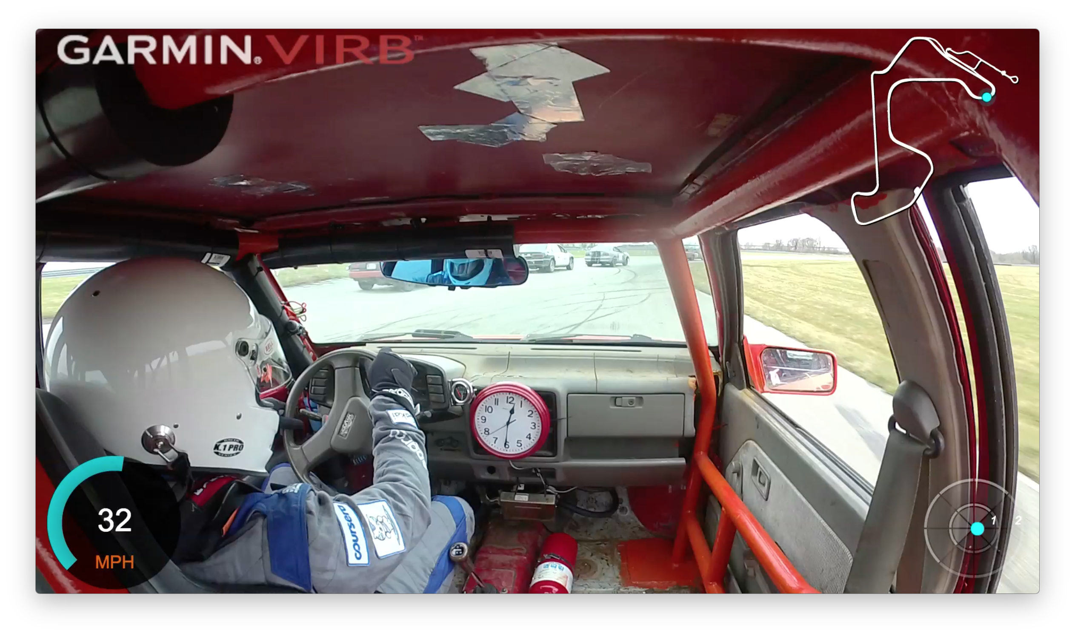


www.dr-chuck.com/racing
www.24hoursoflemons.com

Slide 11
Learning something new is tough Teaching Online is Difficult

Slide 12
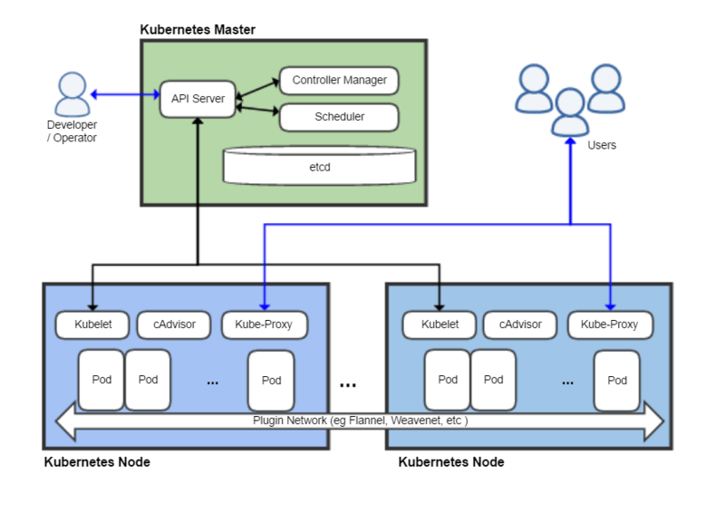

Thursday
May 3, 2018
https://en.wikipedia.org/wiki/Kubernetes

Slide 13
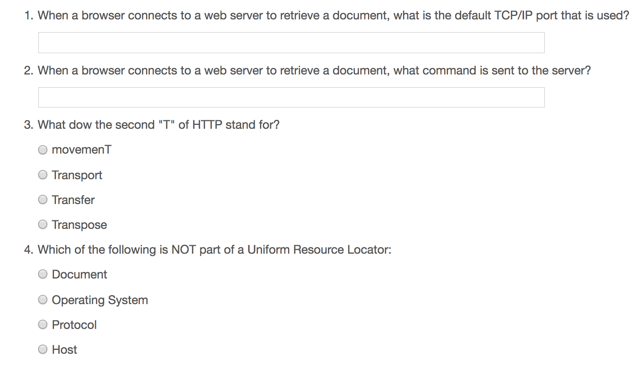
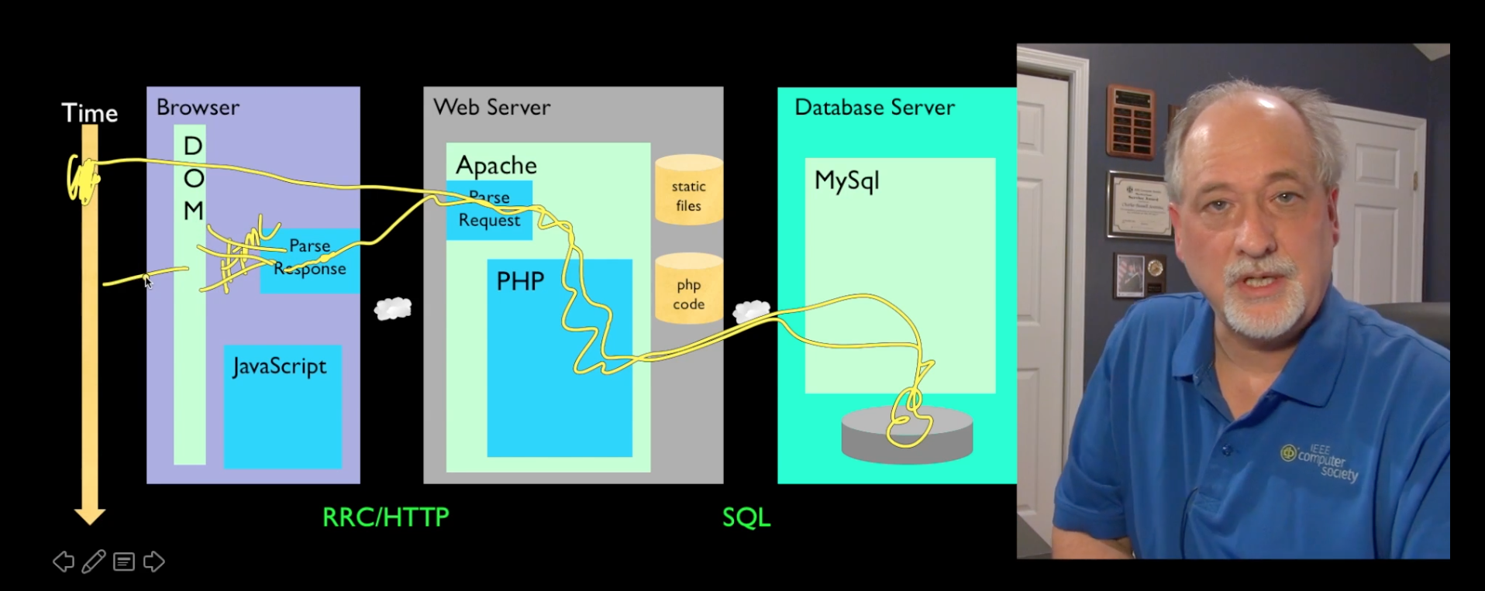
Building a Scalable Online Class
Record Lectures
Build quizzes
Maybe use peer grading

Slide 14
My Path to a Scalable Online Course
Build an open source Learning Management System (LMS) (Sakai)
Build a standard for LMS interoperability / convince the mainstream systems to implement
Write a free textbook / upgrade that textbook / translate the textbook
Build open source software framework to build learning tools (Tsugi)
Build clever / puzzle based assessment software in the framework
Integrate those assessments in on campus courses
Help Coursera write code to integrate my assessments
Build an open source small, standalone MOOC Platform to host those tools (Koseu)
Release all materials for free under Creative Commons / Apache (www.py4e.com)
Build my own social / peer graded assessment software
Record lectures
Build courses with quizzes + engaging assessments
Build a learning community and mentor / empower / support its leaders
Turn the course into a reality show

Slide 15
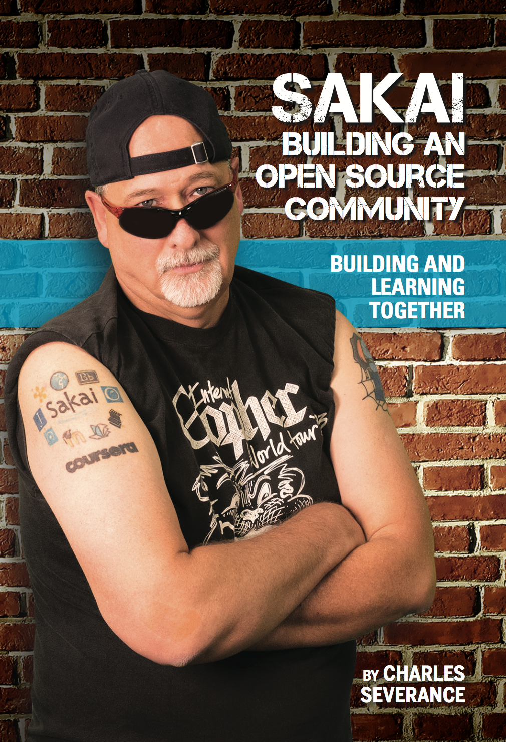

2002 - present
www.sakaiproject.org
www.dr-chuck.com/sakai-book

Slide 16
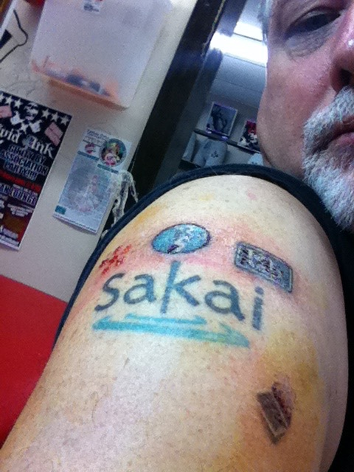
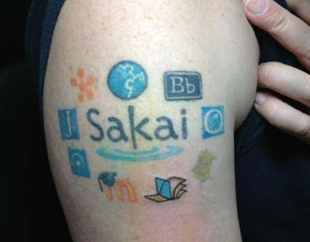
IMS Learning Tools
Interoperability (LTI)
2008-2013

Slide 17

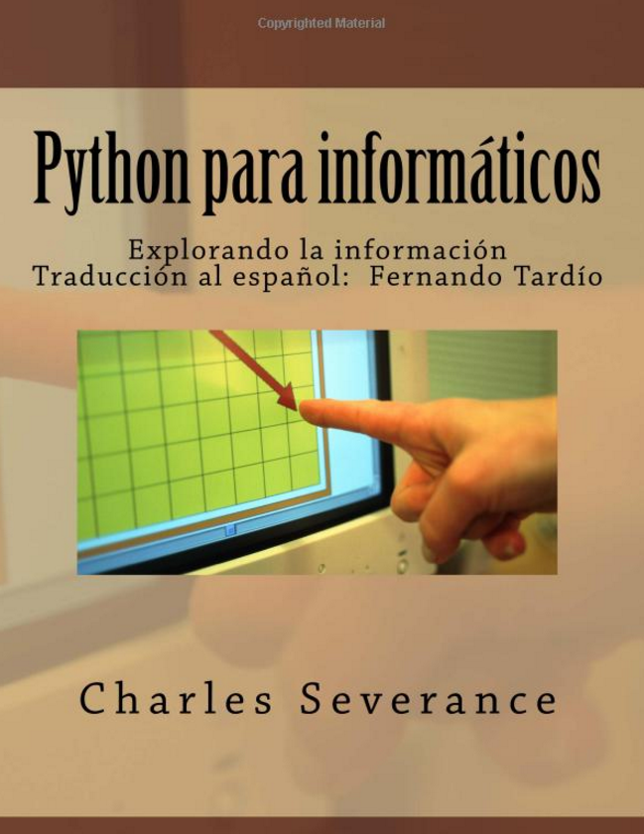

2008 - present

Slide 18
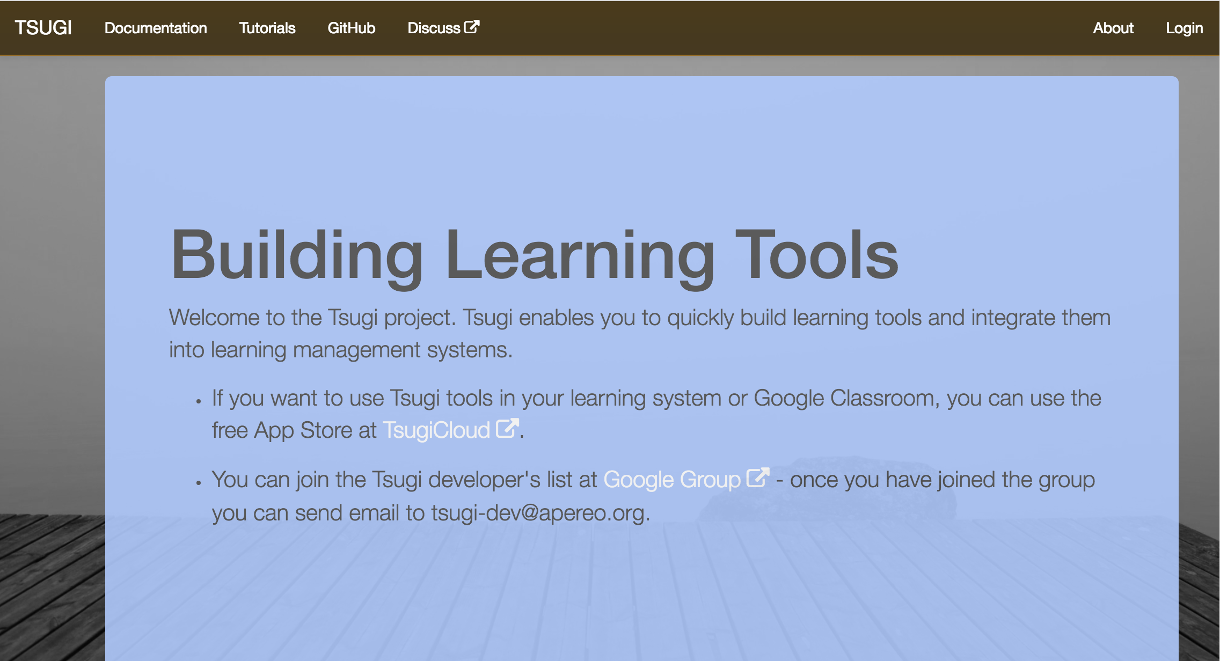
2013 - Present

Slide 19
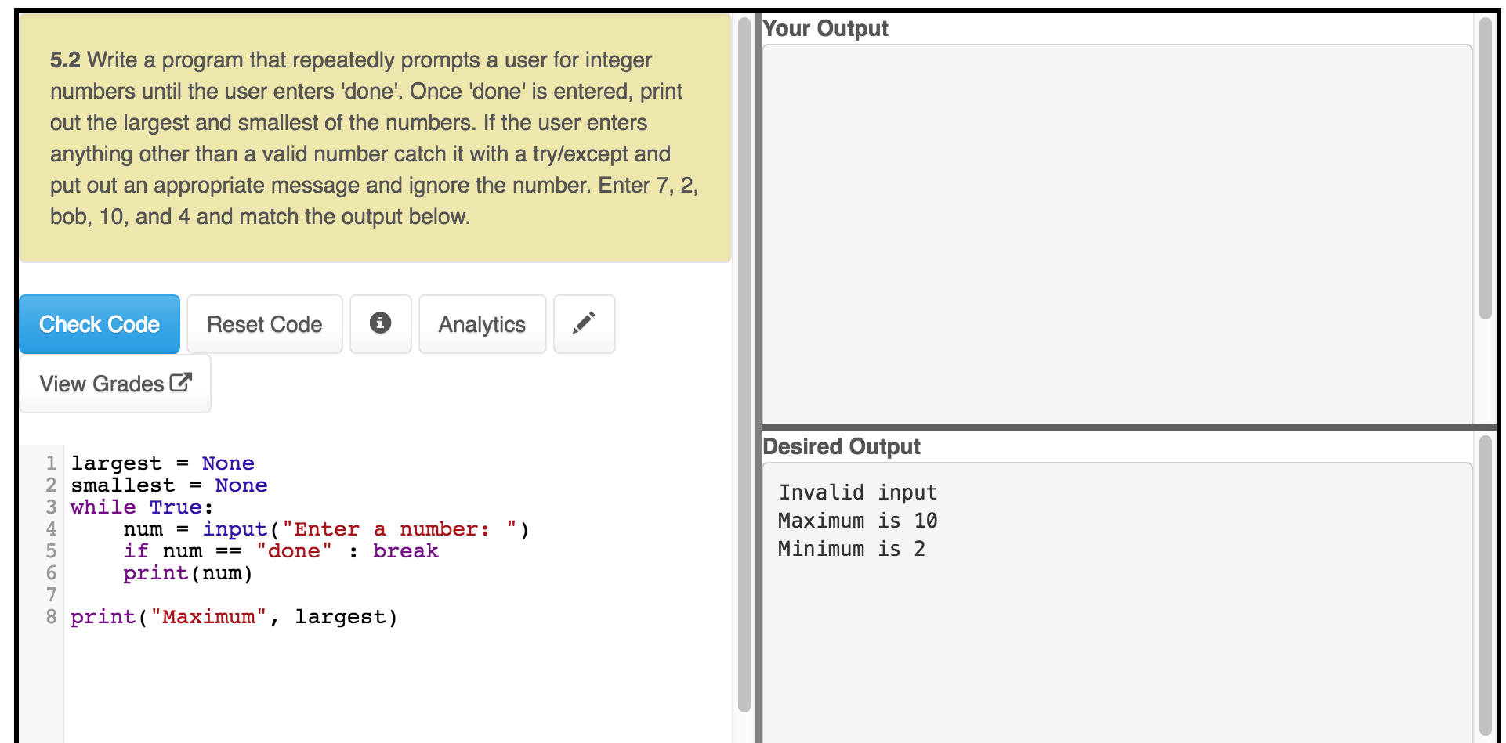
www.py4e.com

Slide 20
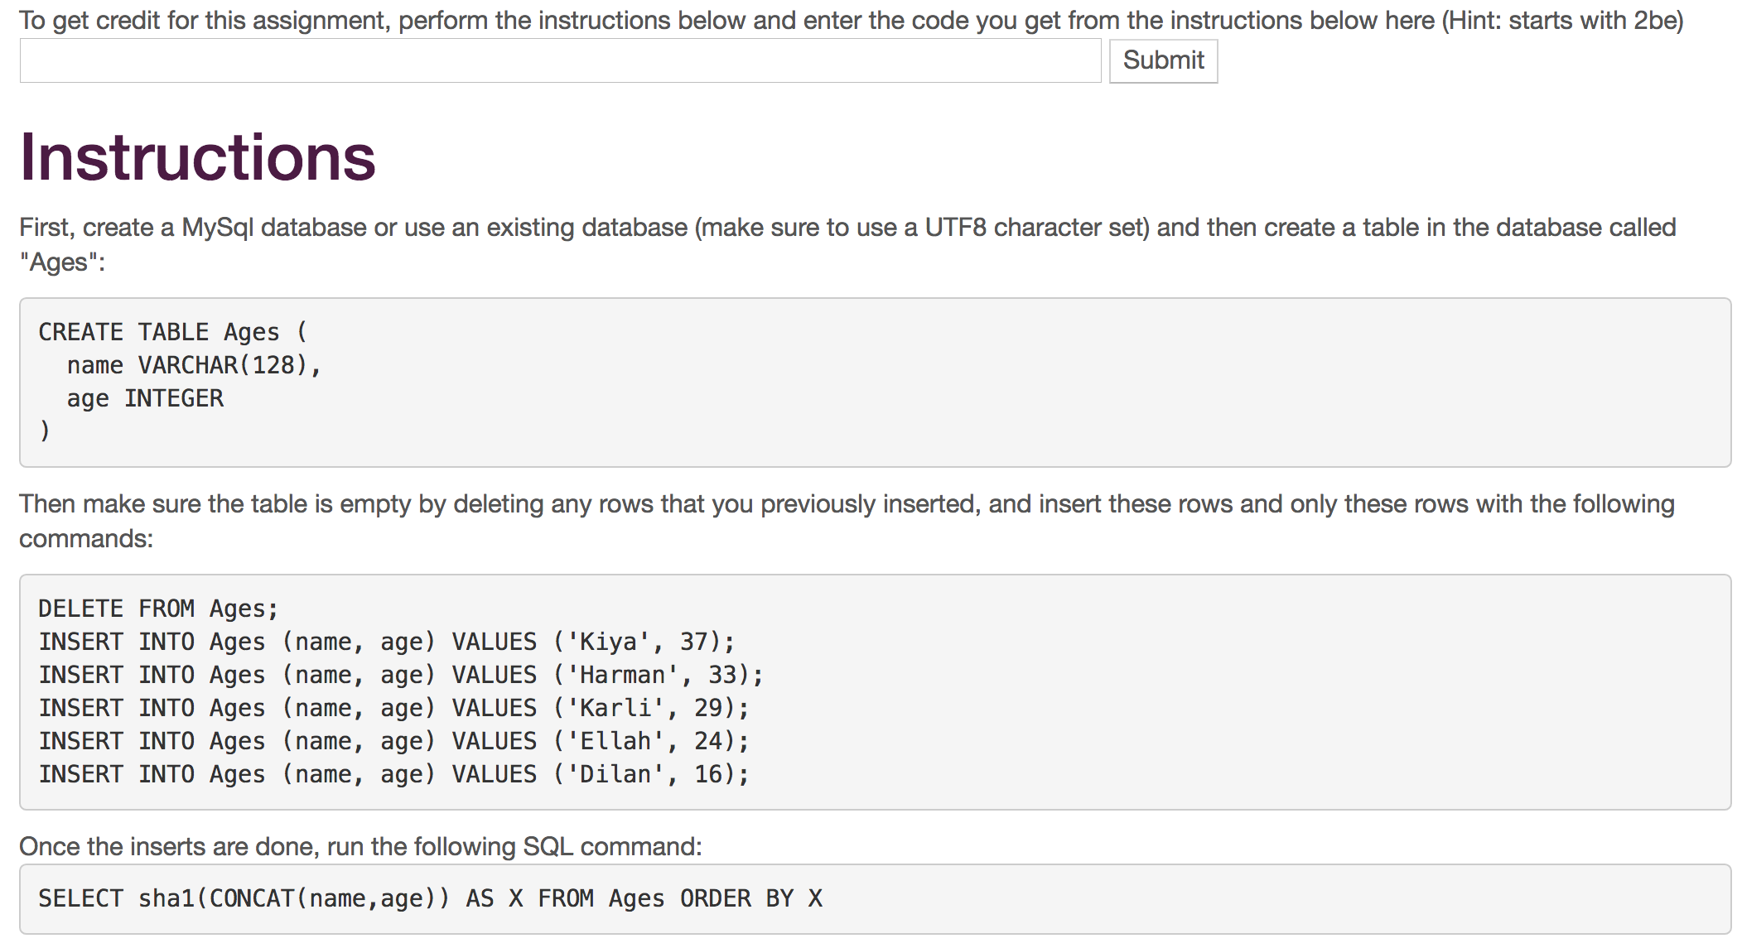
www.wa4e.com

Slide 21
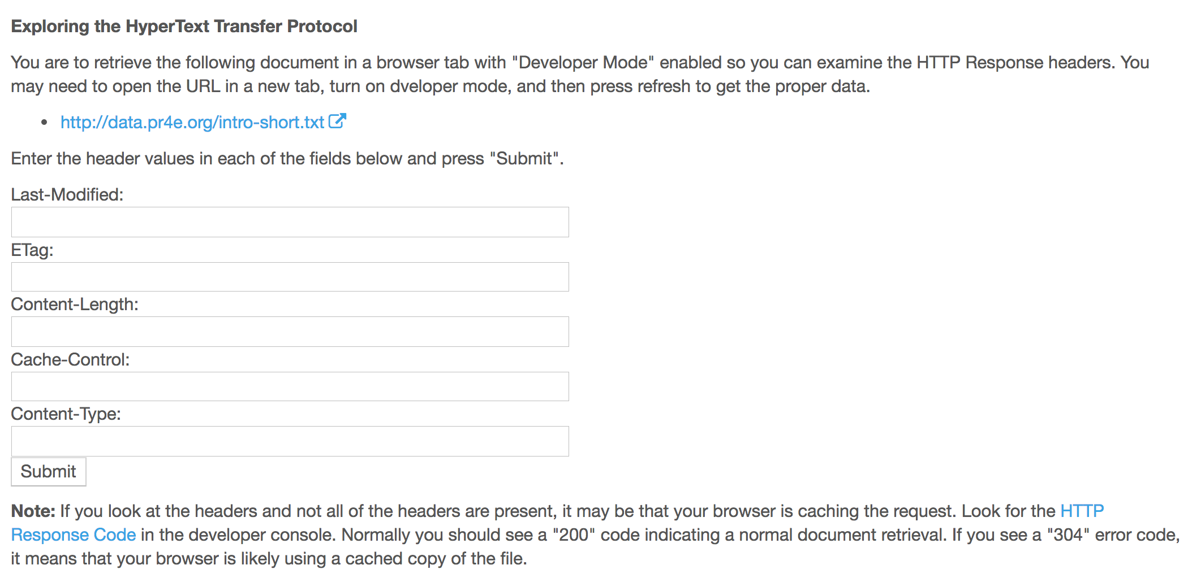
www.wa4e.com

Slide 22
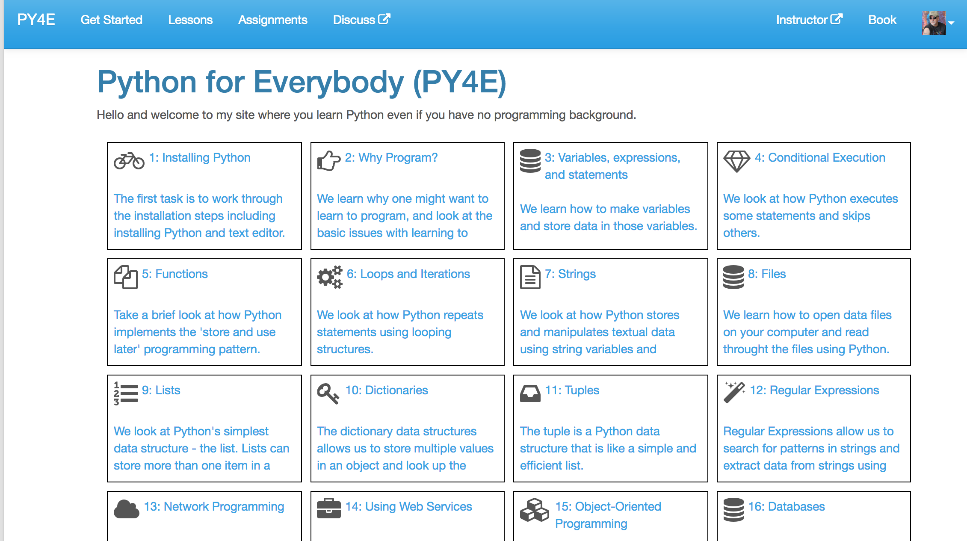
www.py4e.com

Slide 23
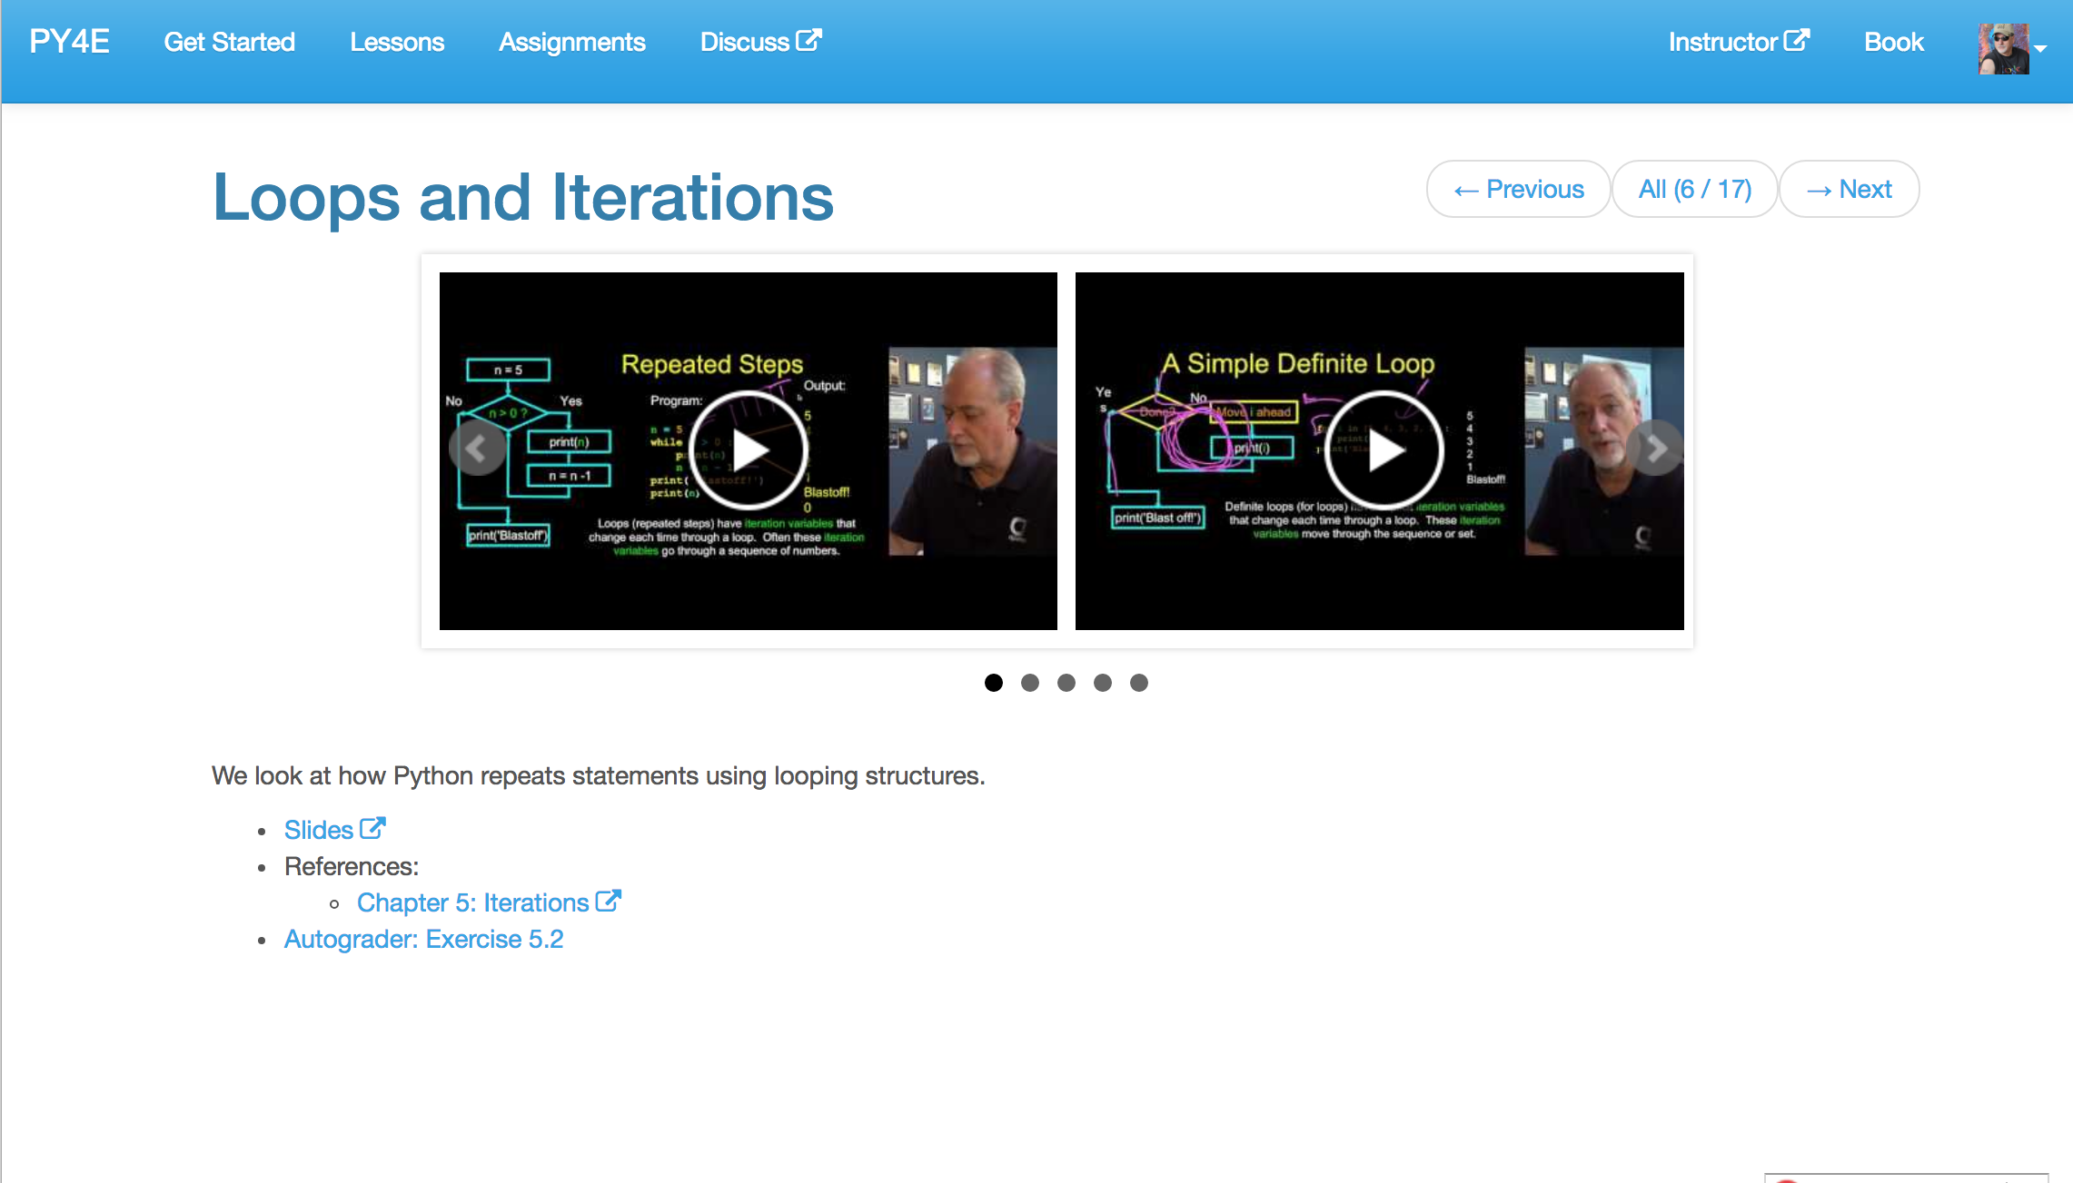
www.py4e.com

Slide 24
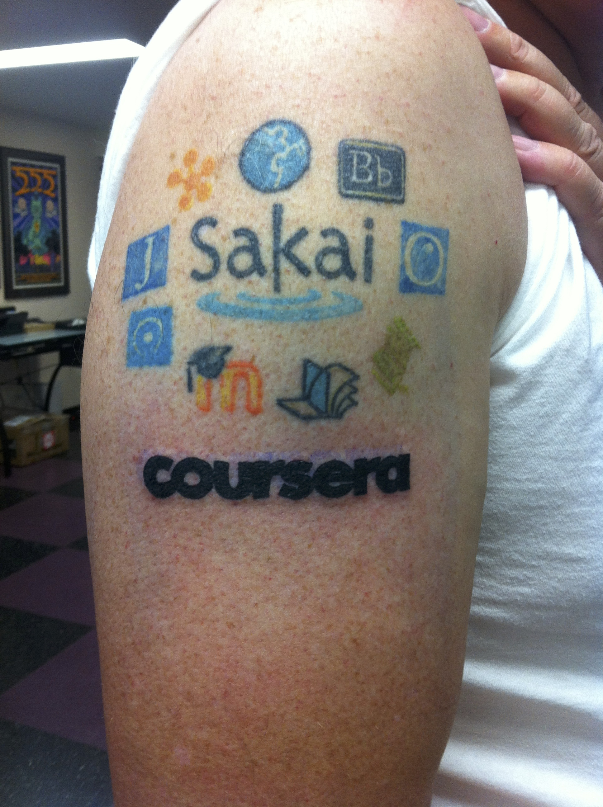
November 2013, I spend two days at Coursera in Mountain View and help them code Learning Tools Interoperability into the product.
That same night, in Redwood City, I add Coursera to my Tattoo.

Slide 25
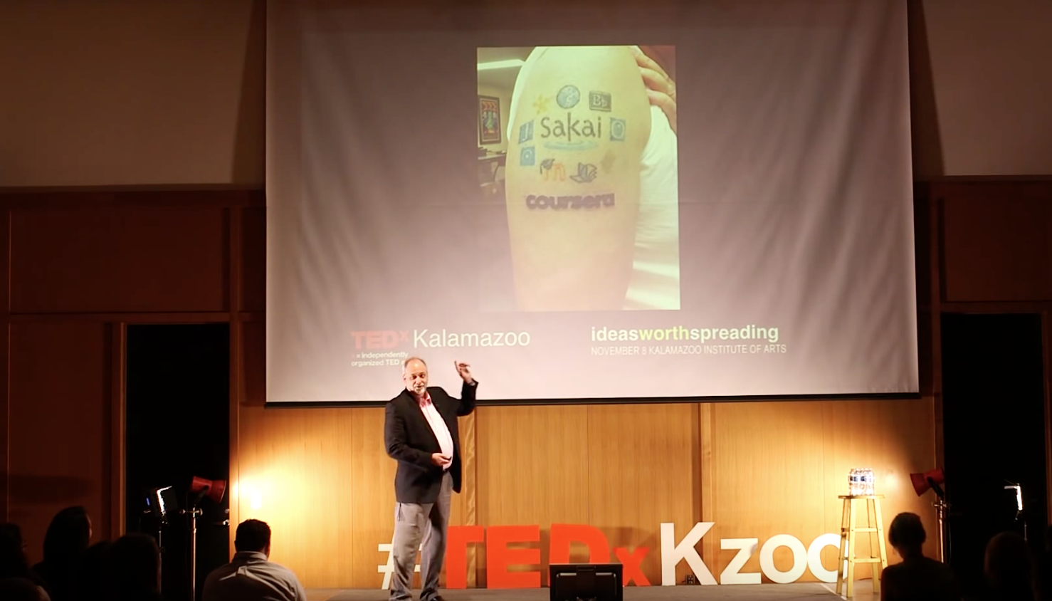
I fly back to Michigan the next day and give a TEDx talk in Kalamazoo.
https://www.youtube.com/watch?v=slscHD40r78

Slide 26
Building Coursera Courses So Far…
Specializations
Python for Everybody (2015)
Web Applications for Everybody (SQL / PHP / JavaScript) (2017)
Courses
Internet History, Technology, and Security (2012)
Python (5)
Web Applications (4)
Teachout (www.teachout.org)
Internet and You with Doug van Houweling (2017)

Slide 27
But there is more…

Slide 28
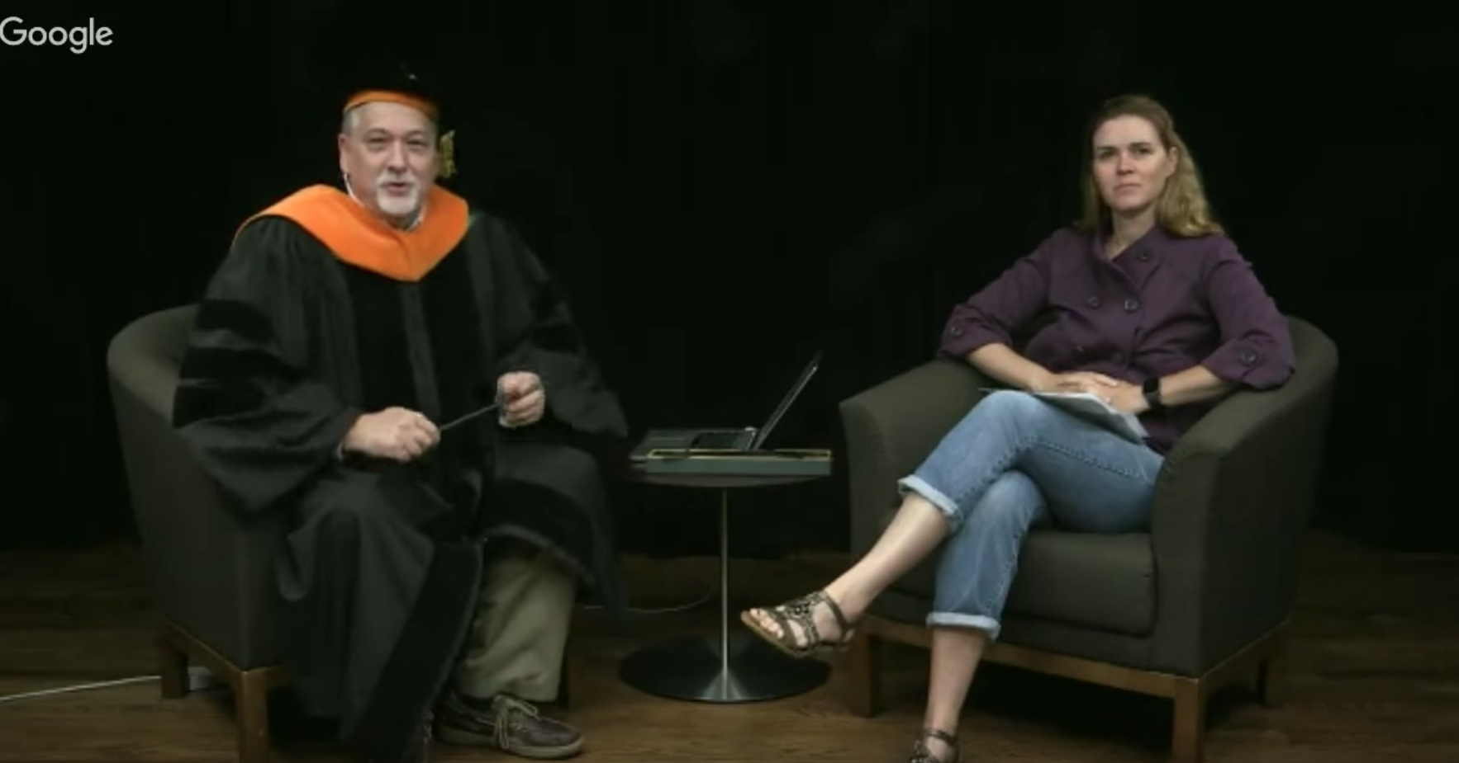
https://www.youtube.com/watch?v=T5N7yxKFn9g

Slide 29
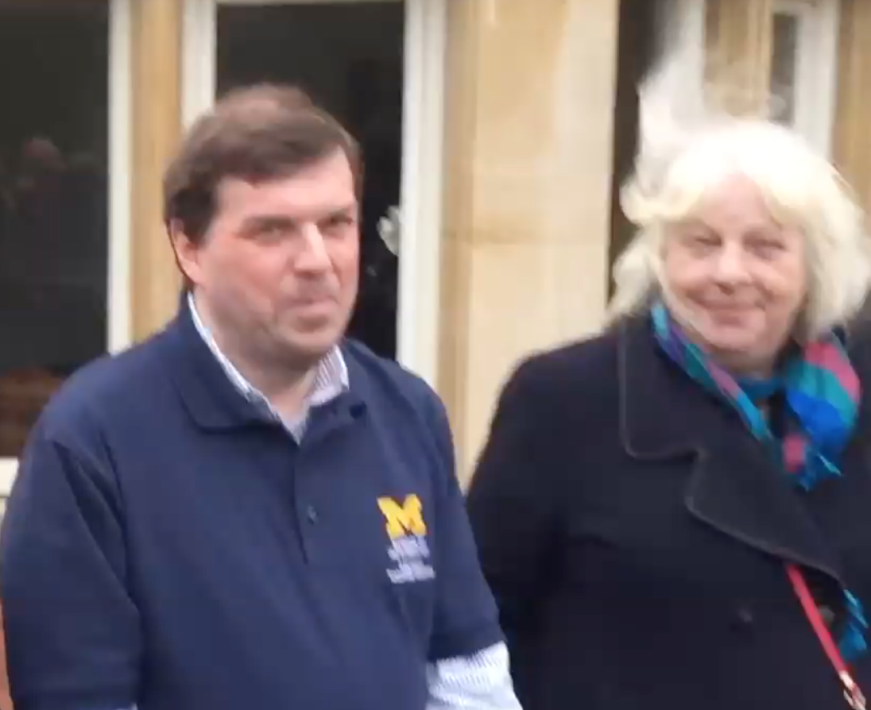
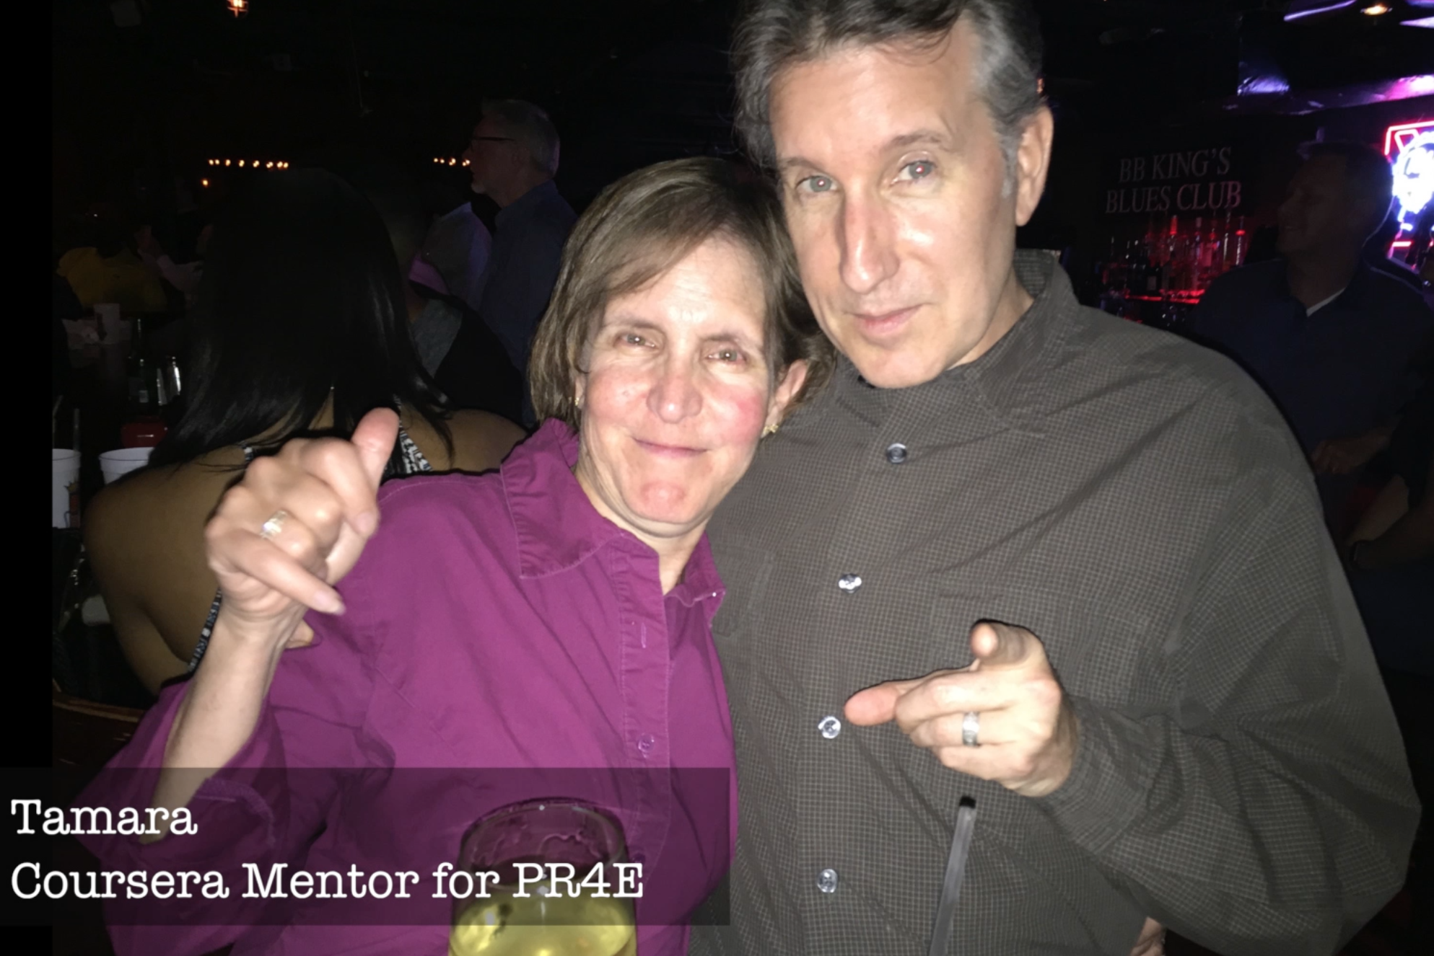
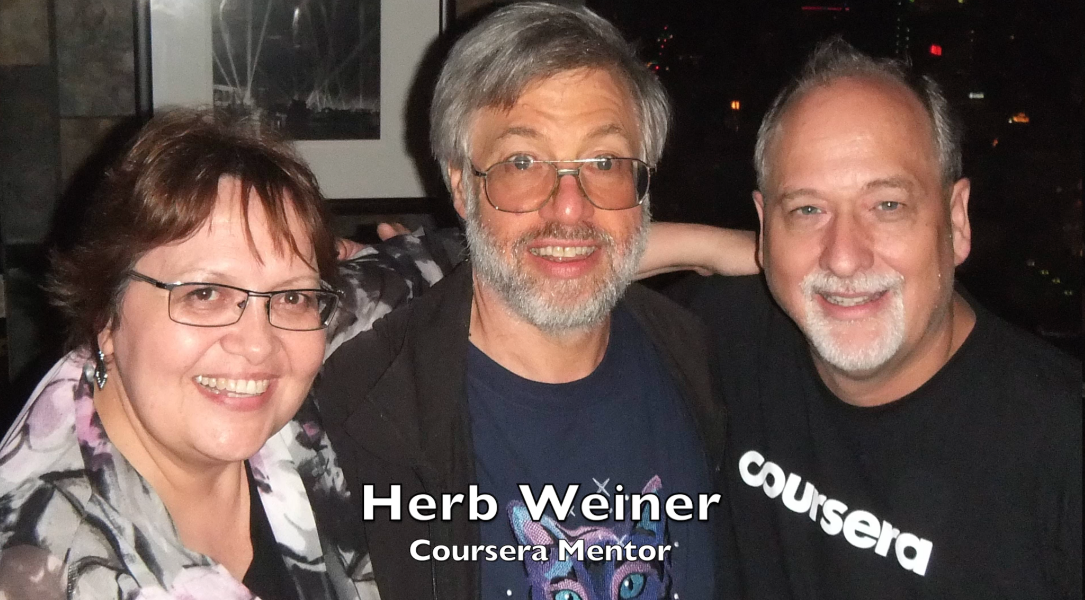
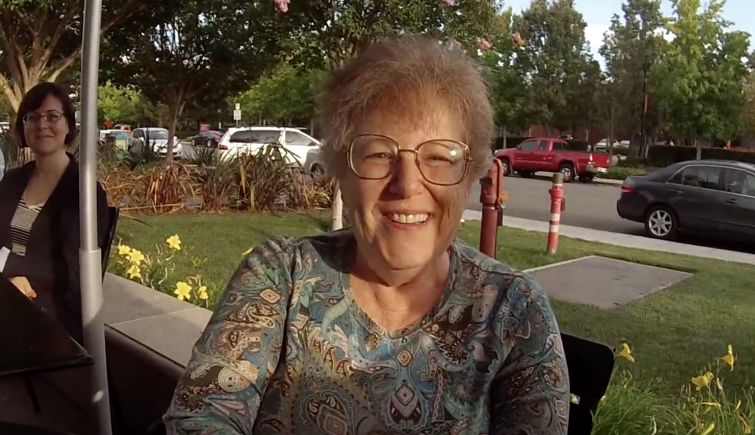
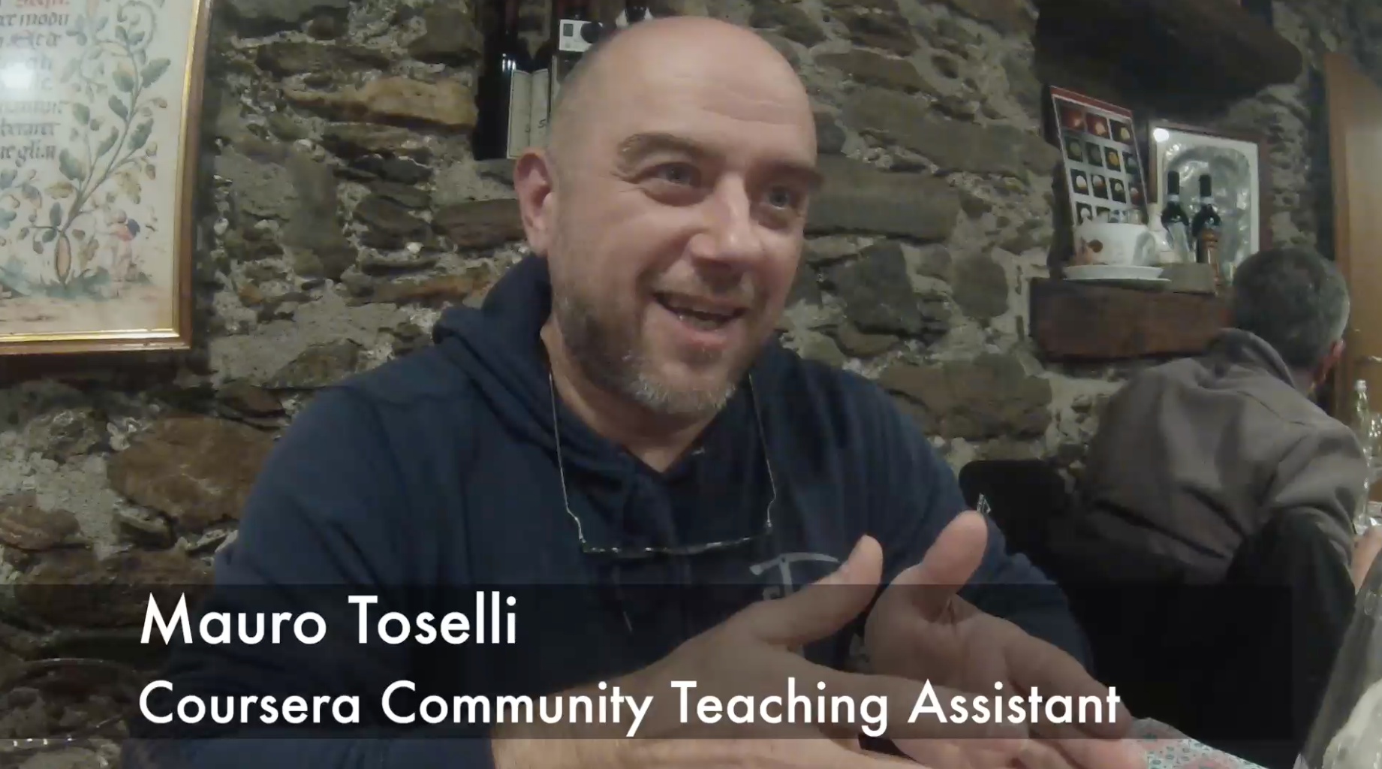

Slide 30
New York, Los Angeles, Ann Arbor, Chicago, Washington DC, Memphis, Seattle, Seoul, Barcelona, London, Mexico City, Amsterdam, Manila Melbourne, Perth...
http://office-hours.dr-chuck.com
Notes:
Since I have a very active travel schedule, I decided to hold office hours in the major cities I have visited. I have held office hours in over 40cities and in each location somewhere between two and 15 students show up.

Slide 31
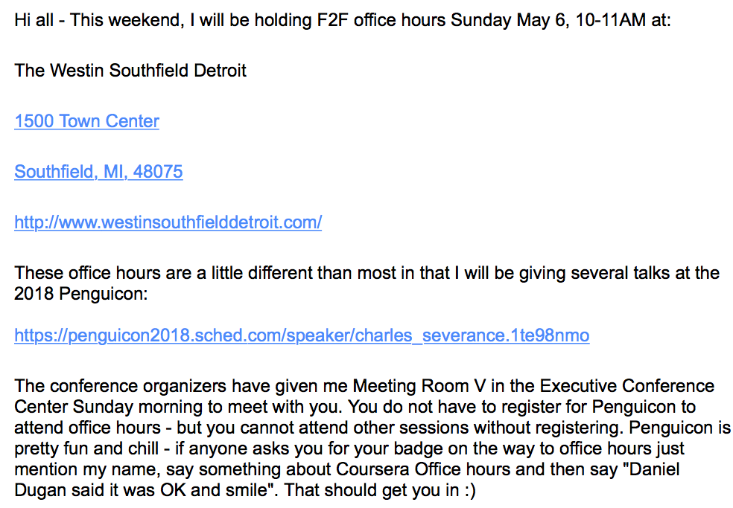

Slide 32
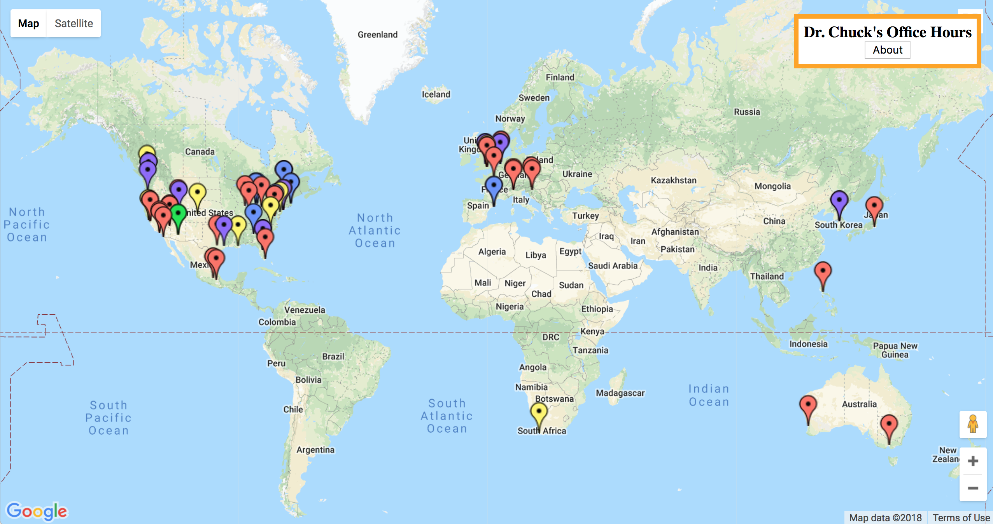
www.dr-chuck.com/office

Slide 33
Roadmap
Build an edtech / open source race car - bring to Penguicon 2019
Create the first standards based application store for education
www.tsugi.org
www.tsugicloud.org
www.learnxp.com
Build More Coursera Specializations (with 100% OER materials)
Django for Everybody
Computer Architecture for Everybody
C Programming for Everybody

Slide 34
Questions / URLs…
EdTech Tools
www.tsugi.org
www.tsugicloud.org
www.learnxp.com
Coursera MOOCs
Python for Everybody
Web Design for Everybody (Colleen)
Web Applications for Everybody
Free MOOCs / CC Materials
www.wa4e.com
www.py4e.com
www.wd4e.com (Colleen van Lent)
Twitter: @drchuck

